Slide 1
Intro to Java
A workshop

Slide 2
Java platform overview
Java technology is used to develop applications for a wide range of environments, from consumer devices to heterogeneous enterprise systems.

Slide 3
The Java language
The Java language has its own structure, syntax rules, and programming paradigm.
The Java language's programming paradigm is based on the concept of object-oriented programming (OOP), which the language's features support.

Slide 4
The Java language
The Java language is a C-language derivative, so its syntax rules look much like C's: for example,code blocks are modularized into methods and delimited by braces ({ and }), and variables are declared before they are used.

Slide 5
The Java language
Structurally, the Java language starts with packages.
A package is the Java language's namespace mechanism.
Within packages are classes, and within classes are methods, variables, constants, and so on.

Slide 6
The Java compiler
When you program for the Java platform, you write source code in .java files and then compile them.
The compiler checks your code against the language's syntax rules, then writes out bytecodes in .class files.
Bytecodes are standard instructions targeted to run on a Java virtual machine (JVM).

Slide 7
The Java compiler
In adding this level of abstraction, the Java compiler differs from other language compilers, which write out instructions suitable for the CPU chipset the program will run on.

Slide 8
The JVM
At run time, the JVM reads and interprets .class files and executes the program's instructions on the native hardware platform for which the JVM was written.
The JVM interprets the bytecodes just as a CPU would interpret assembly-language instructions. The difference is that the JVM is a piece of software written specifically for a particular platform.
The JVM is the heart of the Java language's "write-once, run-anywhere" principle.

Slide 9
The JVM
Your code can run on any chipset for which a suitable JVM implementation is available.
JVMs are available for major platforms like Linux and Windows, and subsets of the Java language have been implemented in JVMs for mobile phones and hobbyist chips.

Slide 10
The garbage collector
Rather than forcing you to keep up with memory allocation (or use a third-party library to do this),
the Java platform provides memory management out of the box.
When your Java application creates an object instance at run time, the JVM automatically allocates memory space for that object from the heap, which is a pool of memory set aside for your program to use.

Slide 11
The garbage collector
The Java garbage collector runs in the background, keeping track of which objects the application no longer needs and reclaiming memory from them.
This approach to memory handling is called implicit memory management because it doesn't require you to write any memory-handling code.
Garbage collection is one of the essential features of Java platform performance.

Slide 12
The Java Development Kit
When you download a Java Development Kit (JDK), you get — in addition to the compiler and other tools — a complete class library of prebuilt utilities that help you accomplish just about any task common to application development.
The best way to get an idea of the scope of the JDK packages and libraries is to check out the JDK API documentation

Slide 13
The Java Runtime Environment
The Java Runtime Environment (JRE) includes the JVM, code libraries, and components that are necessary for running programs written in the Java language.
It is available for multiple platforms.
You can freely redistribute the JRE with your applications, according to the terms of the JRE license, to give the application's users a platform on which to run your software.
The JRE is included in the JDK.

Slide 14
Your development environment
The JDK includes a set of command-line tools for compiling and running your Java code, including a complete copy of the JRE.
Although you certainly can use these tools to develop your applications, most developers appreciate the additional functionality, task management, and visual interface of an IDE.

Slide 15
Your development environment
Eclipse is a popular open source IDE for Java development.
It handles basic tasks, such as code compilation and setting up a debugging environment, so that you can focus on writing and testing code.
In addition, you can use Eclipse to organize source code files into projects, compile and test those projects, and store project files in any number of source repositories.
You need an installed JDK in order to use Eclipse for Java development.

Slide 16
Install JDK
go to http://www.oracle.com/technetwork/java/javase/downloads/index.html
download Java SE 7u51 JDK
run installer, should install to C:\Program Files\Java\jdk1.7.0_51
create JAVA_HOME variable
Notes:
Linux:
Download jdk rpm from oracle
rpm -ivh <jdk rpm>
echo "export JAVA_HOME=/usr/java/default/" >> ~/.bashrc
source ~/.bashrc

Slide 17
Install Eclipse
go to
https://www.eclipse.org/downloads
download Eclipse Standard 4.3.2
unzip and move to C:\eclipse

Slide 18
Setup Eclipse
The Eclipse IDE sits atop the JDK as a useful abstraction, but it still needs to access the JDK and its various tools.
Before you can use Eclipse to write Java code, you have to tell it where the JDK is located.

Slide 19
Setup Eclipse
Launch Eclipse by double-clicking on eclipse.exe
The Workspace Launcher will appear, allowing you to select a root folder for your Eclipse projects.
Choose a folder you will easily remember, such as C:\workspace.
Dismiss the Welcome to Eclipse screen.

Slide 20
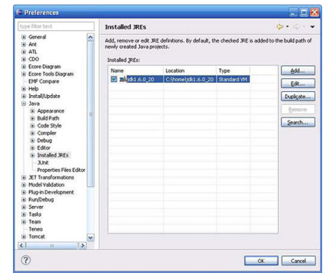
Setup Eclipse
Click Window > Preferences > Java > Installed JREs.

Slide 21
Setup Eclipse
Eclipse will point to an installed JRE.
You need to make sure you use the one you downloaded with JDK.
If Eclipse does not automatically detect the JDK you installed, click Add... and in the next dialog Standard VM, then click Next.
Specify the JDK's home directory (such as C:\Program Files\Java\jdk1.7.0_51 on Windows), then click Finish.
Confirm that the JDK you want to use is selected and click OK.

Slide 22
Eclipse setup complete
Eclipse is now set up and ready for you to create projects and compile and run Java code.

Slide 23
Getting started with Eclipse
Eclipse is not just an IDE, it is an entire development ecosystem.
This section is a brief hands-on introduction to using Eclipse for Java development.

Slide 24
Eclipse development environment
The Eclipse development environment has four main components:
• Workspace
• Projects
• Perspectives
• Views

Slide 25
Eclipse development environment
The primary unit of organization in Eclipse is the workspace.
A workspace contains all of your projects.
A perspective is a way of looking at each project (hence the name), and within a perspective are one or more views.

Slide 26
The Java perspective
Is the default perspective for Eclipse
You should see this perspective when you start up Eclipse
The Java perspective contains the tools you need to begin writing Java applications.
Each tab is a view for the Java perspective.
Package Explorer and Outline are two particularly useful views.

Slide 27
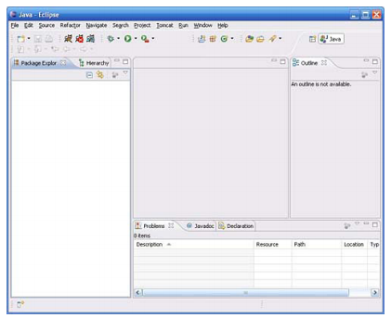
The Java perspective

Slide 28
The Java perspective
The Eclipse environment is highly configurable.
Each view is dockable, so you can move it around in the Java perspective and place it where you want it.
For now, though, stick with the default perspective and view setup.

Slide 29
What is an object?
Structured programming languages like C and COBOL follow a very different programming paradigm from object-oriented ones
The structured programming paradigm is highly data oriented, which means that you have data structures on one hand, and then program instructions that act on that data.
Object-oriented languages like the Java language combine data and program instructions into objects.

Slide 30
What is an object?
An object is a self-contained entity that contains attributes and behavior, and nothing more.
Rather than having a data structure with fields (attributes) and passing that structure around to all of the program logic that acts on it (behavior), in an object-oriented language, data and program logic are combined.
This combination can occur at vastly different levels of granularity, from fine-grained objects like a “Number” to coarse-grained objects such as a “FundsTransfer” service in a large banking application.

Slide 31
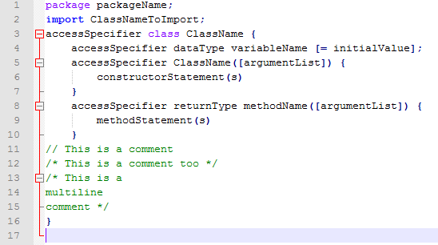
Object definition
Note: square brackets indicate that the constructs within them are not required. The brackets themselves (unlike { and }) are not part of the Java syntax.

Slide 32
Class makeup
Classes can have two types of members:
variables
methods

Slide 33
Variables
The values of a given class's variables distinguish each instance of that class and define its state.
These values are often referred to as instance variables

Slide 34
Methods
A class's methods define its behavior.
Sometimes this behavior is nothing more than to return the current value of an attribute.
Other times, the behavior can be quite complex.

Slide 35
Methods
There are essentially two categories of methods: constructors and all other methods, of which there are many types.
A constructor method is used only to create an instance of a class.
Other types of methods can be used for virtually any application behavior.

Slide 36
Static methods
Static methods are used largely for utility; you can think of them as a way of having global methods.
For example, you use the JDK Logger class to output information to the console.
To create a Logger class instance, you don't instantiate a Logger class; instead, you invoke a static method called getLogger().
The syntax for invoking a static method is different from the syntax used to invoke a method on an object instance. You also use the name of the class that contains the static method, as shown in this invocation:
Logger log = Logger.getLogger("NewLogger");
So to invoke a static method, you don't need an object instance, just the name of the class

Slide 37
The Person Object
I'll start with an example that is based on a common application-development scenario: an individual being represented by a Person object.
Going back to the definition of an object, you know that an object has two primary elements:
attributes and behavior

Slide 38
Attributes
What attributes can a person have? Some common ones include:
Name
Age
Height
Weight
Eye Color
Gender
You can probably think of more (and you can always add more attributes later), but this list is a good start.

Slide 39
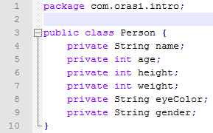
Basic class definition for Person
The basic class definition for Person isn't very useful at this point because it defines only its attributes (and private ones at that).
To be more interesting, the Person class needs behavior — and that means methods.

Slide 40
Behavior
An actual person can do all sorts of things, but object behaviors usually relate to some kind of application context.
In a business-application context, for instance, you might want to ask your Person object, "What is your age?"
In response, Person would tell you the value of its Age attribute.

Slide 41
Behavior
More-complex logic could be hidden inside of the Person object, but for now suppose that Person has the behavior of answering these questions:
What is your name?
What is your age?
What is your height?
What is your weight?
What is your eye color?
What is your gender?

Slide 42
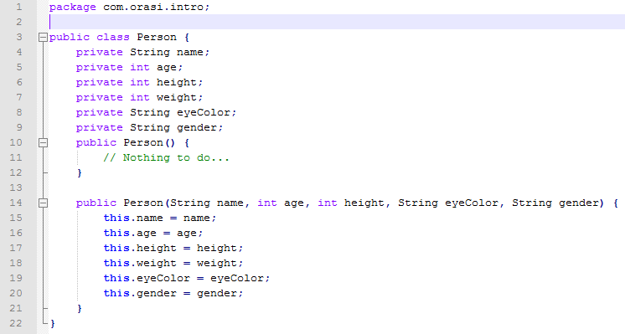
Person class with constructor

Slide 43
Your first Java object
It's time to pull together what you've learned in the previous sections and start writing some code.
This section walks you through declaring a class and adding variables and methods to it using the Eclipse Package Explorer.
You'll learn how to use the Logger class to keep an eye on your application's behavior.
Also how to use a main() method as a test harness.

Slide 44
Create a project
Click on File > New > Java Project ... and you will see a dialog box open

Slide 45
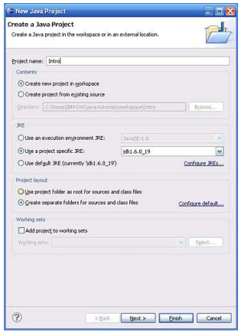
New Java Project Wizard

Slide 46
Create a project
Enter Intro as the project name and click Finish.
If you want to modify the default project settings, click Next. (This is recommended only if you have experience with the Eclipse IDE.)
Click Finish to accept the project setup and create the project

Slide 47
Creating a package
If you're not already there, get to the Package Explorer perspective in Eclipse.
You're going to get set up to create your first Java class.
The first step is to create a place for the class to live.
Packages are namespace constructs, but they conveniently map directly to the file system's directory structure as well.
Rather than use the default package (almost always a bad idea), you'll create one specifically for the code you'll be writing.

Slide 48
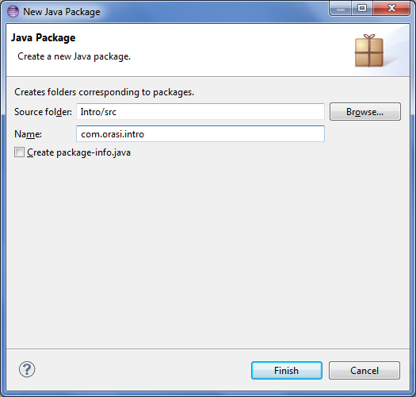
Eclipse Java package wizard
File > New > Package
Type com.orasi.intro
Click Finish

Slide 49
Declaring the class
There's more than one way to create a class from the Package Explorer, but the easiest way is to right-click on the package you just created and choose New > Class.... You will see the New Class dialog box.

Slide 50
New Class dialogue box
In the Name text box, type Person.
Under Which method stubs would you like to create?, check public static void main(String[] args).
Next, click Finish.

Slide 51
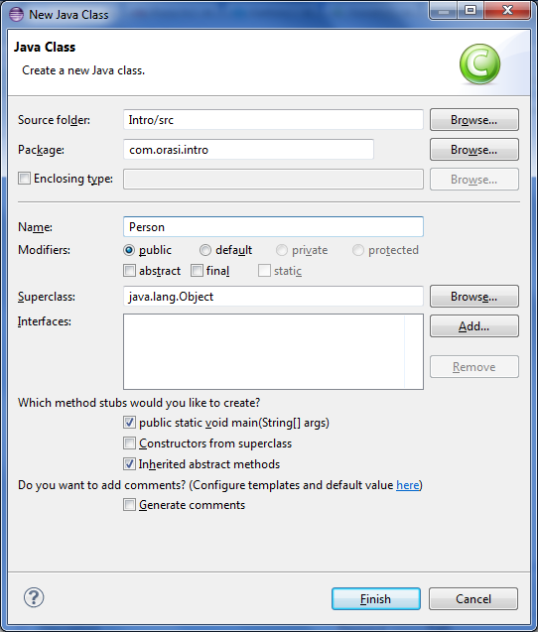
New Class dialogue box

Slide 52
New Class
Eclipse generates a shell class for you and includes the package statement at the top, along with the main() method you asked for and the comments you see.
You just need to flesh out the class now. You can configure how Eclipse generates new classes via:
Window > Preferences > Java > Code Style > Code Templates
For simplicity, you'll go with Eclipse's out-of-the-box code generation.

Slide 53
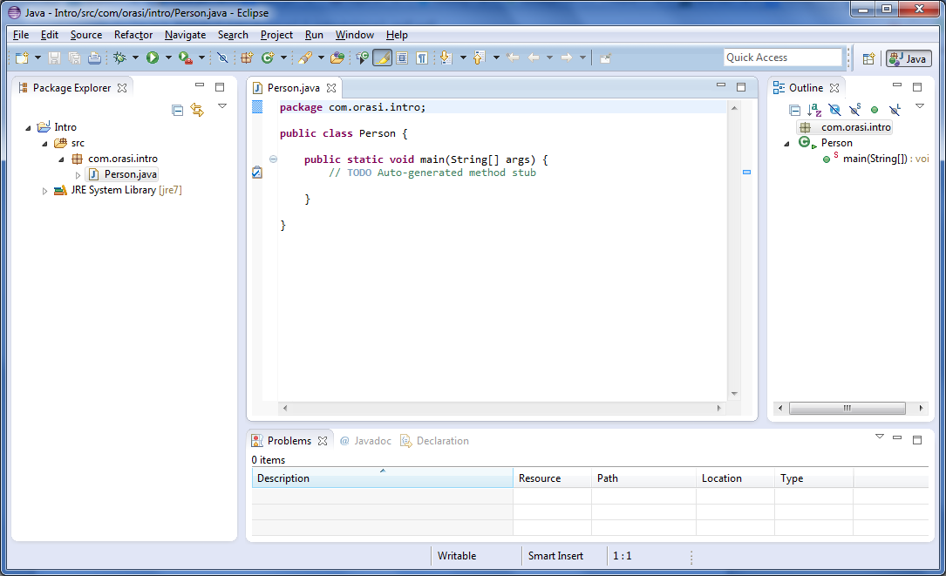

Slide 54
Adding class variables
Recall that a variable has an accessSpecifier, a dataType, a variableName, and, optionally, an initialValue.
Earlier, you looked briefly at how to define the accessSpecifier and variableName.
Now you'll see the dataType that a variable can have.

Slide 55
dataTypes
A dataType can be either a primitive type or a reference to another object.
For example, remember that Age is an int (a primitive type), and Name is a String (an object).
The JDK comes packed full of useful classes like java.lang.String, and those in the java.lang package do not need to be imported (a shorthand courtesy of the Java compiler).
But whether the dataType is a JDK class such as String or a user-defined class, the syntax is essentially the same.

Slide 56
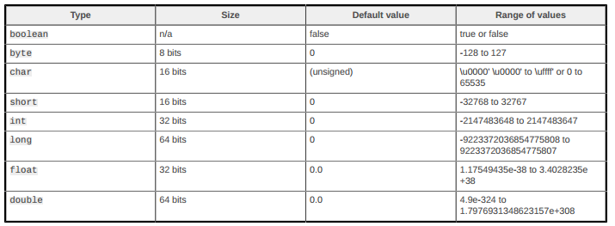
Primitive data types
This table shows the eight primitive data types you're likely to see on a regular basis, including the default values that primitives take on if you do not explicitly initialize a member variable's value:

Slide 57
Built-in logging
Before going further into coding, you need to know how your programs tell you what they are doing.
The Java platform includes the java.util.logging package, a built-in logging mechanism for gathering program information in a readable form.
Loggers are named entities that you create through a static method call to the Logger class, like so:
import java.util.logging.Logger;
//. . .
Logger log = Logger.getLogger(getClass().getName());

Slide 58
Built-in logging
From any regular (that is, nonstatic) method, the previous code will always reference the name of the class and pass that to the Logger.
If you are making a Logger call inside of a static method, just reference the name of the class you're inside of:
Logger log = Logger.getLogger(Person.class.getName());

Slide 59
Using main() as a test harness
main() is a special method that you can include in any class so that the JRE can execute its code.
A class is not required to have a main() method, in fact, most never will.
A class can have at most one main() method.

Slide 60
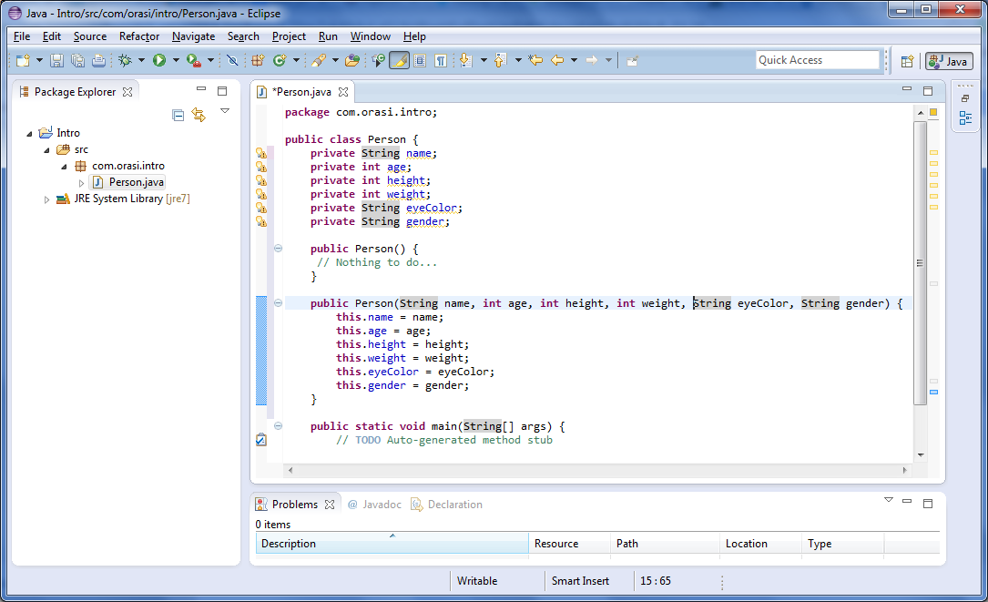
Add our attributes and constructors

Slide 61
Generate getters/setters
Eclipse has a handy code generator to generate getters and setters (among other things).
Right click on Person.java or Person in “public class Person”
Source > Generate Getters and Setters....
Select All
Insertion point: Last Member
Click OK

Slide 62
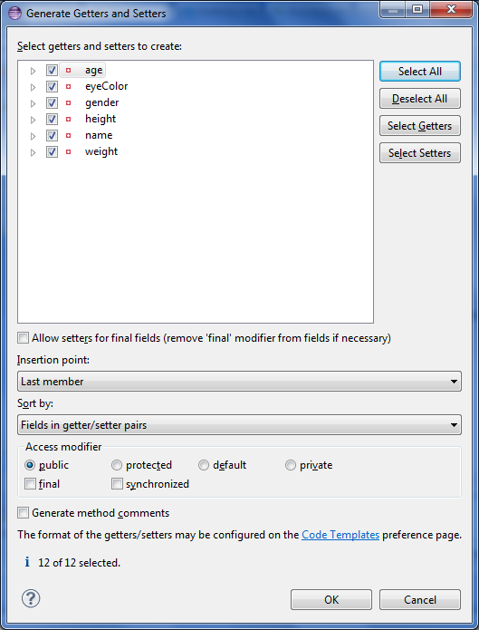

Slide 63
Fill out main method
Logger log = Logger.getLogger(Person.class.getName());
Person dude = new Person("Joe Schmo", 35, 72, 180, "Brown", "MALE");
log.info("Name: " + dude.getName());
log.info("Age: " + dude.getAge());
log.info("Height (in): " + dude.getHeight());
log.info("Weight (lbs): " + dude.getWeight());
log.info("Eye Color: " + dude.getEyeColor());
log.info("Gender: " + dude.getGender());

Slide 64
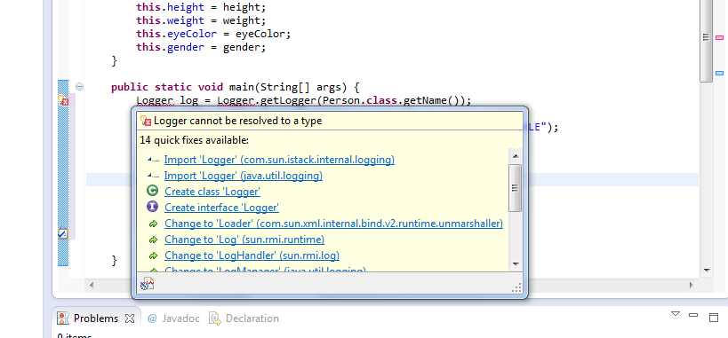
Add logger import

Slide 65
Executing code in Eclipse
To run a Java application from inside Eclipse, select the class you want to run, which must have a main() method.
Select Person, then click the Run icon (which is green and has a small triangular arrow pointing to the right).
When asked, select to run Person as a Java application

Slide 66
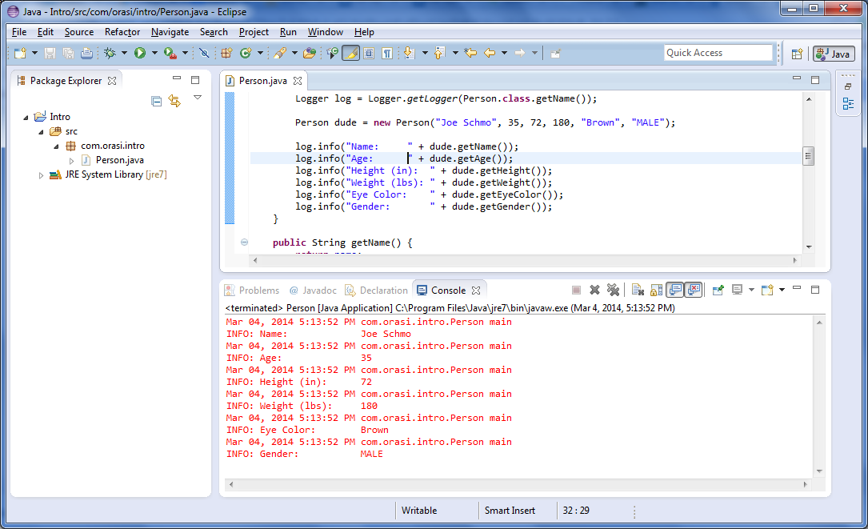

Slide 67
Strings
Handling strings in C is labor-intensive because they're null-terminated arrays of 8-bit characters that you have to manipulate.
In the Java language, strings are first-class objects of type String, with methods that help you manipulate them.
The closest Java code gets to the C world with regard to strings is the char primitive data type, which can hold a single Unicode character, such as ‘a’.

Slide 68
String instantiation
Because Strings are first-class objects in the Java language, you can use new to instantiate them.
greeting = new String("hello")
Setting a variable of type String has the same result, because the Java language creates a String object to hold the literal, then assigns that object to the instance variable.
String greeting = "hello";

Slide 69
Concatenate strings
log.info("Name: " + dude.getName());
The plus (+) sign is shorthand for concatenating Strings in the Java language.

Slide 70
Concatenate example
Let's try concatenating Strings inside of the Person class.
At this point, you have a name instance variable, but it would be nice to have a firstName and lastName.
You could then concatenate them when another object requests Person's full name.
The first thing you need to do is add the new instance variables (at the same location in the source code where name is currently defined):
//private String name;
private String firstName;
private String lastName;

Slide 71
Chaining method calls
Now you can generate getters and setters for firstName and lastName like we did before.
Remove the setName() method, and change getName() to look like this:
public String getName() {
return firstName.concat(" ").concat(lastName);
}
This code illustrates chaining of method calls

Slide 72
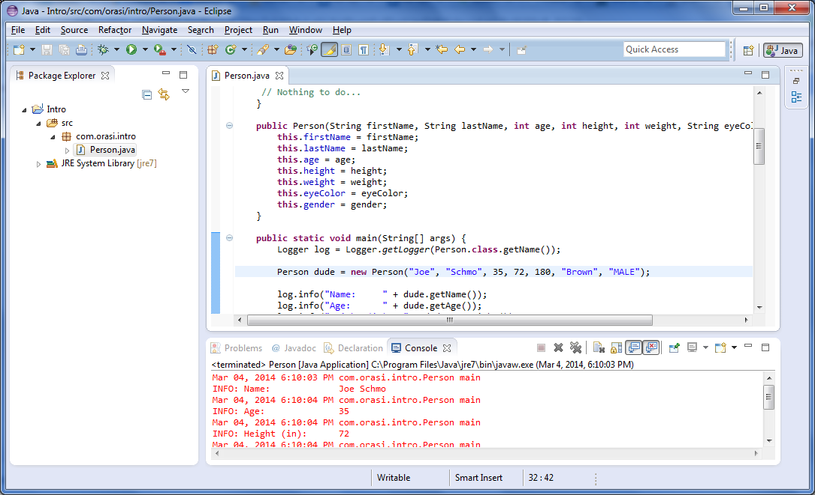

Slide 73
Relational and conditional operators
The Java language gives you operators and control statements that let you make decisions in your code.
Most often, a decision in code starts with a boolean expression (that is, one that evaluates to either true or false).
Such expressions use relational operators, which compare one operand or expression to another, and conditional operators.

Slide 74
The if/else statement
public int getHeight() {
int ret = height;
if (gender.equals("MALE")) {
ret = height + 2;
}
else {
ret = height;
Logger.getLogger("Person").info("Being honest about height...");
}
return ret;
}

Slide 75
Archiving Java code
The JDK ships with a tool called JAR, which stands for Java Archive.
Creating a JAR file in Eclipse is a snap.
Right-click the com.orasi.intro package and select Export.
Choose Java > JAR file
Browse to the location where you want to store your JAR file and name the file “intro”
java -cp /path/to/intro.jar com.orasi.Person

Slide 76
External Archive
So how do you use someone elses 3rd party jar files?
Right-click on project
Select Build Path then Add External Archives…
Browse to jar file

Slide 77
End

Slide 78
Configure proxy for Eclipse
In Eclipse IDE, select “Window –> Preferences”
Choose General -> Network Connections
Select “Manual” from Action Provider drop down list
Select Http in the List and click “Edit” button
Fill in the proxy server host and port number, (fill in the username and password if any)

Slide 79
Install m2eclipse plugin
Help -> Install New Software…
Enter this url at Work with:
http://download.eclipse.org/technology/m2e/releases
Hit Enter (not clicking Add)
Expand, click Select All
Click Next
Click Next
Accept, click Finish
Click Yes to restart Eclipse

Slide 80
Convert to Maven project
Right-click on project in Package Explorer, select Copy
Right-click in Package Explorer, select Paste
Give name: Intro-Maven
Right-click on new project in Package Explorer
Select Configure -> Convert to Maven Project
Enter com.orasi for GroupId
Enter 1.0-SNAPSHOT for Version
Click Finish

Slide 81
Inspect POM file
Click on pom.xml tab
Note tags for src and test directories
Look in your workspace project directory and see where the pom.xml is located

Slide 82
Missing Dependencies?
Click Dependencies tab on pom.xml
Click Add
Enter GAV: junit, junit, 4.11
Select scope: test

Slide 83
JDK vs JRE
Maven requires JDK, so you may need to configure if using a JRE.
Right-click project
Build Path -> Configure Build Path…
Select Libraries tab
Select JRE System Library
Click Edit
Change to Workspace default JRE

Slide 84
Run
Click run icon (green triangle)
Select Clean
Click again select Install

Slide 85
Other Maven Eclipse config
Click Windows -> Preferences
Select Maven

